Slide 1
Developing ChatBot 2-2 Plan Your ChatBot
Refresh-Foods Inc.
Yestin Yehoon Lee

Slide 2
Process of Making New Web App
Conception
Plan
Design
Develop
Test
Notes:
Making a new app need computer programmer.
But they are not only people to it.
But also they need help from designer and coordinator, who give Idea and design for the app.

Slide 3
Group Activity
Group into 2~3 people
1
Brainstorm designs
2
Evaluate feasible or not
4
list functions
3

Slide 4
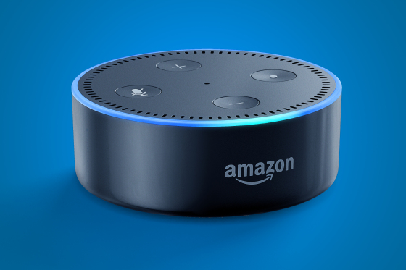
Design Example
Group: Chris, Yestin
Name: Music player Bot
Function: Play/pause music, add to playlist, shuffle, next/previous track
Notes:
https://www.youtube.com/watch?v=hPXS7rC1PWo

